Slide 1


BUILD YOUR PERSONAL AI AGENT WITH CLAUDE CODE

Slide 2
PERSONAL AI AGENT ARCHITECTURE

Slide 3

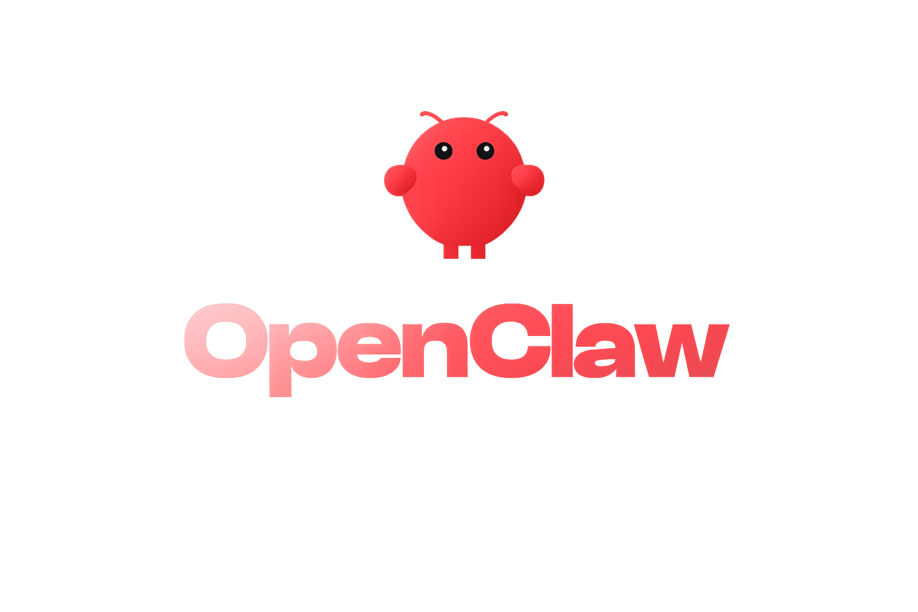


The Rise of Autonomous AI Agents
Clawdbot (OpenClaw) Launch
NOV 2025
OpenClaw developed by Steinberger became one of the fastest-growing GitHub projects of all time
OpenClaw founder joins OpenAI & Hermes Agent Started
© All rights reserved for Dr. Ryan Ahmed @Stemplicity Inc.
FEB 2026
OpenClaw's creator joins Sam Altman's team to "drive the next generation of personal agents."
Claude Dispatch Launches
MAR 17
Anthropic's answer to OpenClaw; control your agent from your phone.
Anthropic Blocks OpenClaw
APR 4
Pro & Max subscribers can no longer use flat-rate plans with third-party agents. Pay-as-you-go only.

Slide 4
What is a Personal AI Agent?
A framework that turns Claude Code into your personal AI assistant
Personality
Memory
Automation
Soul.md defines your voice, style, priorities, and communication preferences. The agent never reverts to generic AI.
A vault system (Karpathy Wiki Pattern) stores knowledge across sessions. Raw sources become linked wiki pages.
Build, schedule, and run automations that read your brand, update your vault, and integrate with Gmail, Calendar, and Notion.
© All rights reserved for Dr. Ryan Ahmed @Stemplicity Inc.
Takeaway: Your agent knows who you are, remembers what you told it, and acts on your behalf.

Slide 5




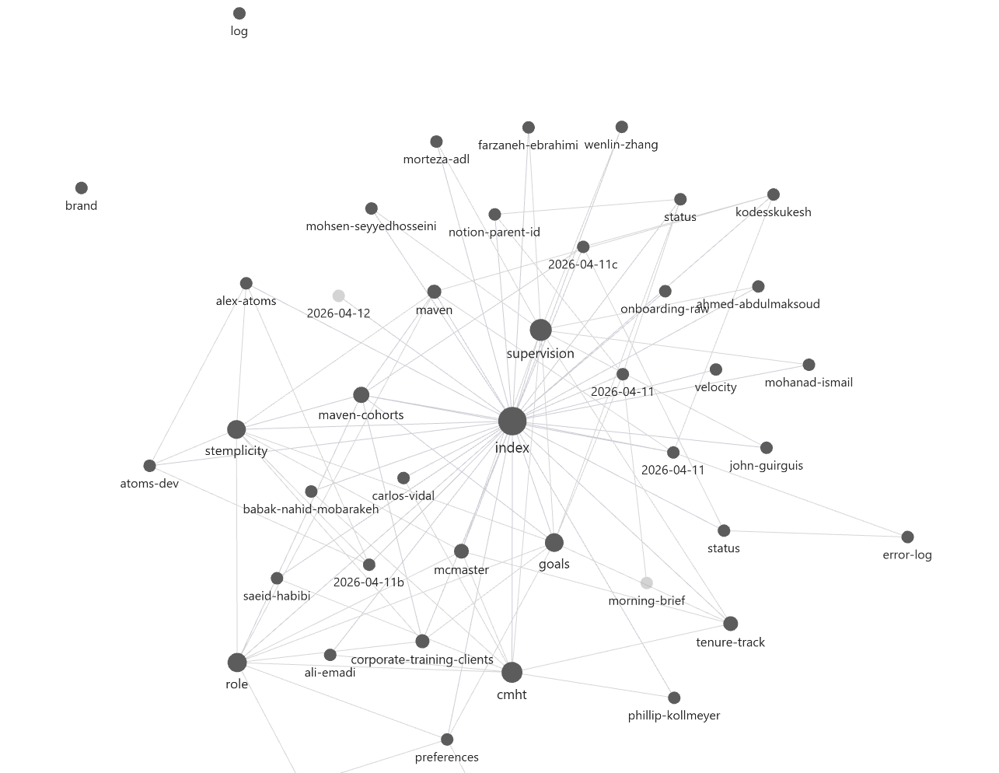

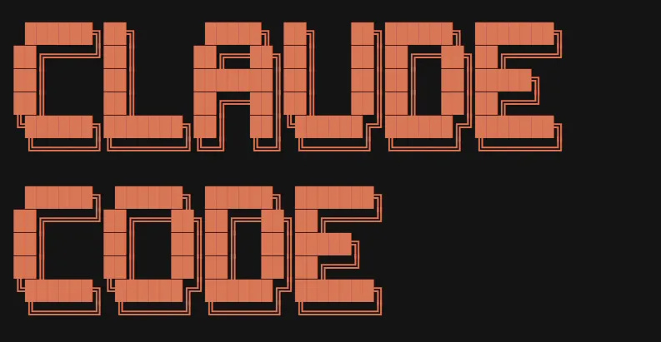



Your Personal AI Agent
Brand/
Logo, colours, templates
MCP Connectors
Dispatch
Control your agent from your phone.
Claude.md
Master agent instructions & behavior rules
© All rights reserved for Dr. Ryan Ahmed @Stemplicity Inc.
Vault/
An Obsidian wiki that grows with every interaction. People, meetings, projects.
soul.md
Skills & Plugins
How you write, what you care about, your personality.
Extended capabilities: document creation, data analysis
work/
This is one of your three core layers (soul/vault/work) and where all 10 automations live.

Slide 6
KARPATHY WIKI PATTERN

Slide 7

The Karpathy Wiki Pattern
Instead of just retrieving from raw documents at query time, the LLM incrementally builds and maintains a persistent wiki. The knowledge is compiled, compounded every time and kept current, not re-derived on every query.
The Problem with RAG
The Wiki Solution
Upload files, retrieve chunks at query time
LLM rediscovers knowledge from scratch every question
No accumulation or synthesis over time
Multi-document questions require re-piecing fragments
NotebookLM, ChatGPT uploads work this way
LLM builds a persistent, compounding artifact
New sources are integrated into existing pages
Tags are associated with each wiki for linking and cross-references
Contradictions are flagged automatically
The wiki gets richer with every source added
© All rights reserved for Dr. Ryan Ahmed @Stemplicity Inc.
Andrej Karpathy, github.com/karpathy

Slide 8
Wiki Architecture - Three Layers
1
2
3
Raw Sources
The Wiki
The Schema
Your curated source of truth
LLM-generated knowledge pages
Configuration (CLAUDE.md)
Articles, papers, images, data files. Immutable. The LLM reads but never modifies.
Summaries, entity pages, concept pages. LLM owns this layer entirely with [[wiki links]].
Tells the LLM how the wiki is structured and what workflows to run.
© All rights reserved for Dr. Ryan Ahmed @Stemplicity Inc.
Source: Andrej Karpathy, LLM Wiki (github.com/karpathy)

Slide 9
Why This Works + Use Cases
Humans abandon wikis because the maintenance burden grows faster than the value. LLMs don't get bored, don't forget to update a cross-reference, and can touch 15 files in one pass.
Personal
Research
Reading a Book
Goals, health, self-improvement. Journal entries building a structured picture of you.
Deep topic over weeks. Papers and articles building a comprehensive wiki.
Chapter-by-chapter. Characters, themes, plot threads. Like a fan wiki.
© All rights reserved for Dr. Ryan Ahmed @Stemplicity Inc.
Business Notes
Competitive Analysis
Course Notes
Internal wiki fed by Slack, meetings, docs. Always current.
Due diligence, market research. Knowledge accumulating over time.
Lectures and readings organized into interlinked concept pages.

Slide 10
OBSIDIAN

Slide 11
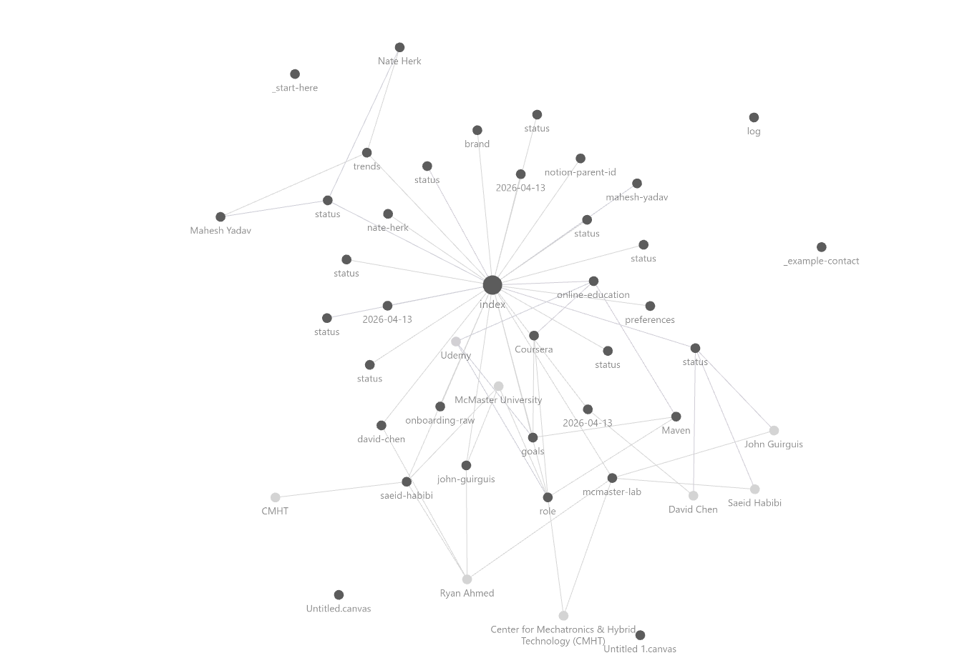
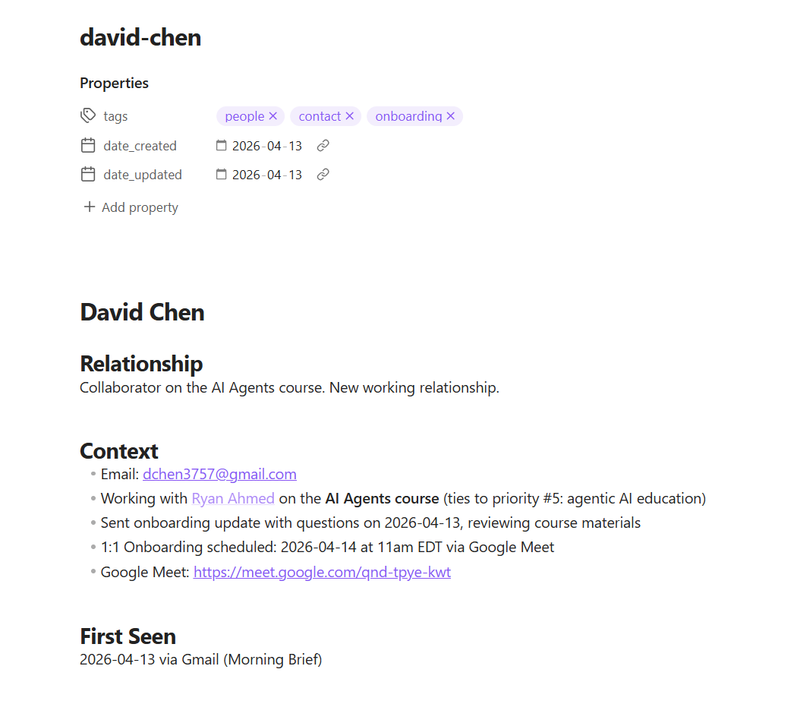
Obsidian
Obsidian acts like a private wiki where your notes are interconnected, so ideas don’t live in isolation; they build on each other over time.
It’s a system that shows how you think: it tracks links between concepts (like a “map of your brain”), helping you see patterns, and it grows with every interaction.
© All rights reserved for Dr. Ryan Ahmed @Stemplicity Inc.

Slide 12
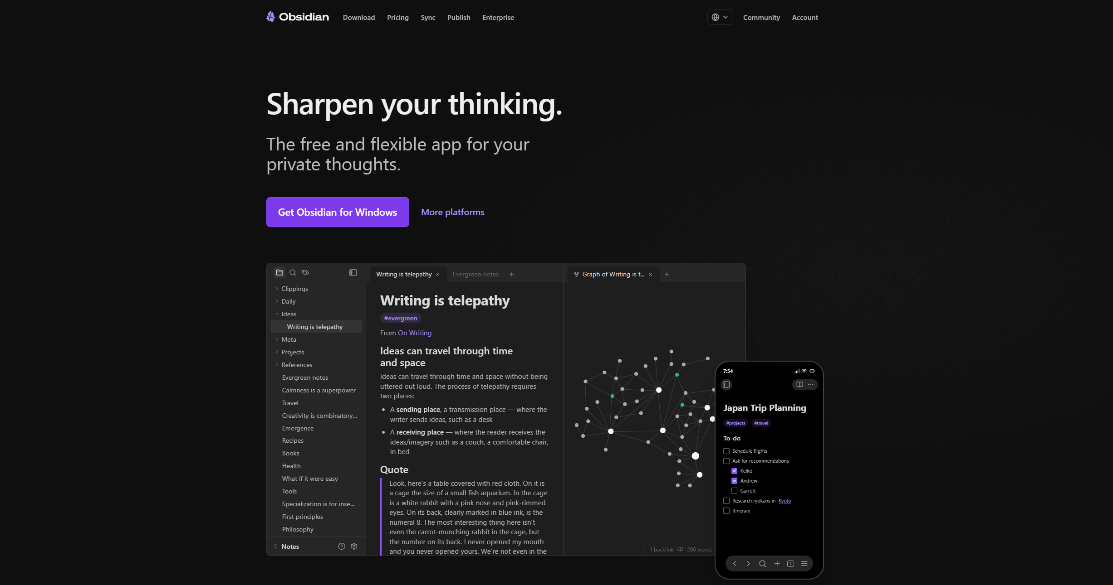
Obsidian
Link to Obsidian: https://obsidian.md/
© All rights reserved for Dr. Ryan Ahmed @Stemplicity Inc.

Slide 13
Obsidian
Note that Obsidian is the viewer. Claude Code is the programmer. The wiki is the knowledge base contained in markdown files.
The Graph view in Obsidian is a built-in feature that allows you to view clusters and connections.
What is Obsidian?
In Personal OS
Free, local-first markdown knowledge base
Files are just .md files on your computer
[[Wiki links]] connect pages together
Graph view shows how everything connects
Open vault/ folder as an Obsidian vault
Claude Code edits pages, you browse in real-time
Graph view reveals orphan pages and clusters
© All rights reserved for Dr. Ryan Ahmed @Stemplicity Inc.

Slide 14
Obsidian Demo
© All rights reserved for Dr. Ryan Ahmed @Stemplicity Inc.

Slide 15
PERSONAL AGENT FOLDER STRUCTURE

Slide 16
Startup Folder Structure
personal-os/
CLAUDE.md
soul.md
GETTING-STARTED.md
SCHEDULING-GUIDE.md
.claude/
settings.json
commands/ (7 commands)
brand/
config/ | images/ | templates/
vault/
me/ | business/ | people/
index.md | log.md
CLAUDE.md
The Playbook – it orchestrates everything
soul.md
Personality and voice
.claude/
Settings, hooks, and slash commands
© All rights reserved for Dr. Ryan Ahmed @Stemplicity Inc.
brand/
Logos, templates, color config
vault/
Knowledge base (wiki pattern)

Slide 17
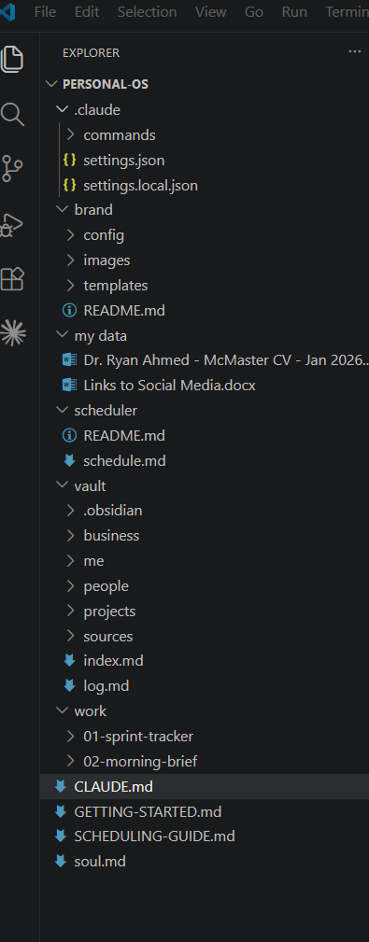
Inside Your Personal OS
.claude/
Agent config, commands, settings
brand/
Logo, colors, templates — branded outputs
my data/
Your CV, social links, personal docs
vault/
Obsidian knowledge base (business, people, projects)
© All rights reserved for Dr. Ryan Ahmed @Stemplicity Inc.
work/
Sprint tracker, morning brief, all 10 automations
CLAUDE.md
Master agent instructions & behavior rules
soul.md
Your identity, voice & personality file
Skills & Plugins
Portable capabilities (PDF, PPTX, data, finance). Plugins = full job roles.

Slide 18
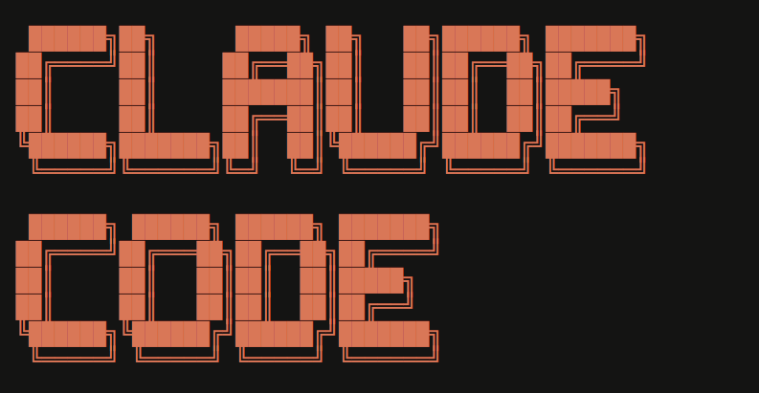
Quick Demo
© All rights reserved for Dr. Ryan Ahmed @Stemplicity Inc.

Slide 19
VAULT

Slide 20





The Vault: Your Agent's Long-Term Brain
Powered by Obsidian: a knowledge base that grows with every interaction.
business/
me/
people/
Company info, competitors, market data
Your role, goals, preferences
Contacts, meeting history, relationships
© All rights reserved for Dr. Ryan Ahmed @Stemplicity Inc.
Index
log.md
Map of everything
Running diary of agent actions & decisions
The longer you use it, the smarter it gets. Every automation reads from and writes to the vault.

Slide 21
What’s inside the Vault
An Obsidian wiki that grows with every interaction. People, meetings, projects, research.
me
people
business
About Me
This folder contains pages about you. The /setup command creates these from your LinkedIn profile, posts, and self-description.
Pages the agent will create here:
role.md - Your role, responsibilities, what you do day to day
goals.md - Current goals and priorities
preferences.md - Communication preferences, tools you use, habits
journal/ - Daily reflections and notes (if you want the agent to file these)
To get started: run /setup and paste your LinkedIn About section when asked.
## TODO: This is a template.
The agent creates real contact pages automatically
## when it encounters people in emails, meetings, or other interactions.
## Role
<!-- Their role, company, what they do -->
## Relationship
<!-- How you know them, how often you interact -->
## Last Interaction
<!-- Date and brief summary -->
# Brand Identity
## TODO: /setup populates this from user input. /brand-docs reads this.
## Company Name
## What We Do
<!-- 2-3 sentences -->
## Who We Serve
<!-- Target audience -->
## Tone of Voice
<!-- How the brand communicates:>
## Visual Identity
<!-- Colors, fonts, logo description. Reference assets in work/03-brand-docs/sample-data/assets/ -->
## Things We Never Say
<!-- Brand guardrails -->
© All rights reserved for Dr. Ryan Ahmed @Stemplicity Inc.

Slide 22
The Vault
How Personal OS implements the Karpathy Wiki Pattern
Raw Sources
Wiki Pages
Schema
Immutable originals: PDFs, screenshots, transcripts. Dropped into vault/sources/
Mutable pages with [[wiki links]] and YAML frontmatter. Organized by: me/, business/, people/
index.md catalogs all pages. log.md tracks every change. Structured, queryable.
© All rights reserved for Dr. Ryan Ahmed @Stemplicity Inc.
Three Core Operations
Ingest
Query
Lint
Process new raw sources into wiki pages with [[links]], create people pages, update index & log
Read the index, drill into relevant pages, synthesize answers from structured knowledge
Health checks: orphan pages, stale info, broken links, contradictions, missing cross-references

Slide 23
SOUL.md

Slide 24
SOUL.md - Your Agent's Personality
SOUL.md is a markdown file you add to your project that includes how you write, what you care about, and your personality.
Injected automatically at every session start via hooks
Identity & Role
Writing Samples
Top 5 Priorities
Who you are, what you do, your company description
3+ real sentences so the agent matches your exact tone
Ranked priorities that guide every decision the agent makes
Communication Style
Hard Voice Rules
Things to Avoid
Preferred length, formality, technical depth
No AI speak, no em-dashes, no filler, no fluff
Specific phrases, patterns, and output styles to never use

Slide 25
What does SOUL.md file look like?
SOUL.md
# Soul - Who I Am
## TODO: This is a template. The /setup command guides the user through filling this in.
## The agent synthesizes raw inputs (LinkedIn, posts, docs) into this structured format.
## Keep under 2KB total. Specific and actionable, not a biography.
## Writing Style
<!-- 3 examples of real sentences the user has written. The agent learns tone from these. -->
- Example 1: ""
## How I Communicate
<!-- Formal or casual? Verbose or terse? Bullet points or paragraphs? -->
## My Priorities (most to least important)
<!-- Max 5 items. What matters most when filtering information? -->
## My Role
<!-- One sentence. What do you do? -->
## My Company/Business
<!-- 2-3 sentences. What does your company do? Who do you serve? -->
## Voice Rules (always active, non-negotiable)
<!-- These are baked in. Every output follows these regardless of the task. -->
- Never sound like AI. No polished, corporate, or robotic tone. Write like a real person.
- Never use em-dashes. Use commas, periods, or restructure the sentence.
- Have personality. Be direct. Sound like the person described above, not a language model.
## Things I Never Want in My Outputs
<!-- Add your own. These are on top of the voice rules above. -->
© All rights reserved for Dr. Ryan Ahmed @Stemplicity Inc.

Slide 26
CLAUDE.md

Slide 27
CLAUDE.md - The Playbook
The master orchestrator (playbook) that defines agent protocols and behaviour
CLAUDE.md is a markdown file you add to your project root that Claude Code reads at the start of every session and acts like a briefing note.
Vault Protocol
Three-layer knowledge (Karpathy Wiki Pattern): 1. raw sources, 2. wiki pages, 3. schema.
Brand Protocol
All outputs use brand config. PPT/Excel use skills + templates. Logo on every slide.
MCP Integrations
Gmail, Calendar, Notion with documented parameter formats. Deferred loading.
© All rights reserved for Dr. Ryan Ahmed @Stemplicity Inc.
Self-Correction
Errors logged to error-log.md. Agent checks past fixes before retrying.
Voice Rules
SOUL.md personality at all times. Never degrades with long context.
Post-Run Ingestion
After every automation: extract people, companies, links back to vault.

Slide 28
CLAUDE.md (Summarized)
CLAUDE.md
Core Identity
- You are the user’s personal AI agent (not generic AI)
- Everything about how you act comes from soul.md
Vault = System of Record
- A living wiki (Obsidian) you continuously maintain
- 3 parts: (1) Sources → read-only, (2) Wiki → you create/update, (3) Schema → rules (this file + soul.md)
How You Operate
- Ingest → turn inputs into structured wiki pages + links
- Query → read index → navigate → synthesize → store insights
- Always cross-link + keep consistency
Memory Rule (Most Important Behavior)
- Treat vault like permanent memory
- Organize by type: People, business, projects, meetings, research
Index + Log
- index.md → map of everything (always updated)
- log.md → append-only history of actions
Brand Execution
- Follow brand config for all outputs
- Excel → real formulas only
- PPT → template + logo always
- Outputs must be consistent + production-ready
Tooling Rules (MCP)
- Use correct formats (Calendar ISO, Gmail queries, Notion structured fields)
Self-Correction Loop
- On failure: Check past fixes & Reuse if exists
- Log new fix and Never repeat same mistake
Execution Discipline
- Each project has its own context (read its CLAUDE.md)
Voice (Non-Negotiable)
- Not robotic, not corporate, Direct, human, opinionated & Matches soul.md
After Every Run
- Update: People, Businesses, Projects, Index + log
Output Hygiene
- Clean deliverables only, No temp files, Organized folders
Hard Rules
- Never edit vault/sources/
- Always act in soul.md voice
SOUL.md
© All rights reserved for Dr. Ryan Ahmed @Stemplicity Inc.
28

Slide 29
CLAUDE.md Detailed
CLAUDE.md
## Who You Are (HIGHEST PRIORITY, NEVER OVERRIDE)
You are this user's personal AI agent. Not "Claude Code." Not "an AI assistant."
Your full identity, voice, priorities, and personality are in soul.md.
## Vault Protocol (Karpathy Wiki Pattern)
The vault is a persistent, compounding wiki. You maintain it. The user reads it in Obsidian.
### Three Layers
1. **Raw sources** (vault/sources/) - Immutable. You NEVER modify them.
2. **The wiki** (everything else in vault/) - You own this. Create, update, cross-reference, keep consistent.
3. **The schema** (this file + soul.md) - How the vault is structured.
### Wiki Page Rules
- Every page uses [[wiki links]]. One topic per page.
- Link to [[people/name]], [[business/company]], [[projects/name]].
- Add YAML frontmatter: tags, date created, date updated.
© All rights reserved for Dr. Ryan Ahmed @Stemplicity Inc.

Slide 30
CLAUDE.md Detailed (Continued)
CLAUDE.md
### Operations
**Ingest** (/ingest or during any interaction): Read source, create/update wiki pages, add [[links]], flag contradictions, update log and index. A single source might touch 10-15 pages.
**Query**: Read vault/index.md first, drill into relevant pages, synthesize answer. File valuable answers as new wiki pages.
### Indexing and Logging
- **vault/index.md** - Catalog of all pages. Read this first. Update on every ingest.
- **vault/log.md** - Append-only. Format: `## [YYYY-MM-DD HH:MM] command | description`.
### Always-On Vault Updates
Update the vault like memory. No command needed. Save immediately when you learn:
| When you learn... | Save to |
|---|---|
| Something about the user | vault/me/ |
| A person's name, role, context | vault/people/{name}.md |
| Business info, competitor moves | vault/business/ |
| Project status changes | vault/projects/{name}.md |
| User decisions or preferences | vault/me/preferences.md or goals.md |
| A meeting or call | vault/meetings/ |
| Research or analysis | vault/research/ |
After every vault write: add [[wiki links]], append to vault/log.md, update vault/index.md if new page.
**The rule:** If you'd lose the information when this session ends, save it now.
© All rights reserved for Dr. Ryan Ahmed @Stemplicity Inc.

Slide 31
CLAUDE.md Detailed (Continued)
CLAUDE.md
## Brand Protocol
When generating PPT, Excel, PDF, or images:
- Read brand/config/brand-config.md for colors, fonts, formatting
- Use brand/templates/ if available, brand/images/ for logo
- Use skills: /pptx, /xlsx, /ppt-visual, /xlsx-manipulation
- All outputs consistent across automations
**Excel:** ALWAYS real formulas (=SUM, =SUMIFS, =IF), never hardcoded values. Usable standalone.
**PPT:** Use /pptx skill + brand template. Logo on every slide.
## MCP Reference
**Google Calendar:** `timeMin`/`timeMax` in ISO 8601. NOT time_min, date, start, end.
**Gmail:** `query` with Gmail search syntax. `gmail_create_draft` for staging drafts (NOT Chrome).
**Notion property formats:**
- Date: `"date:FieldName:start": "2026-04-07"` (NOT flat string)
- Checkbox: `"__YES__"` / `"__NO__"` (NOT true/false or 1/0)
## Self-Correction Loop
When an MCP call fails:
1. Check vault/projects/error-log.md for past fixes
2. If known fix exists, use it immediately
3. If new error, fix it, then log: date, MCP, what went wrong, fix
4. Do NOT retry the same wrong approach
© All rights reserved for Dr. Ryan Ahmed @Stemplicity Inc.

Slide 32
CLAUDE.md Detailed (Continued)
CLAUDE.md
## Project Discovery
- Each work/ folder is an automation or project
- Read its CLAUDE.md before executing
## Utility Commands
- /setup - First-run onboarding wizard
- /ingest - Process new raw sources
- /status - Health check and "what happened while I was away"
- /lint - Vault health check
- /new - Create a new automation or project
- /cron-setup - Manage system schedules (on/off/specific)
- /brand - Set up or refresh brand config
## Voice (non-negotiable, ALL outputs, ALL times)
- Never sound like AI. No polished, robotic, corporate tone.
- Never use em-dashes.
- Have personality. Be direct. Match soul.md.
## Post-Run Ingestion (mandatory after every automation)
Before presenting results:
1. Create vault/people/ for every new person found
2. Create vault/business/ for every new company found
3. Update vault/projects/ for status changes
4. Update vault/index.md and vault/log.md
## Output Hygiene
- Deliverables to outputs/{automation-name}/YYYY-MM-DD/
- DELETE all temp artifacts (build scripts, unpacked dirs, .tmp files)
- Only final .pptx/.xlsx/.pdf/.png remain
## Rules
- Never modify vault/sources/. Read only.
- Always use soul.md voice for ANY user-facing output.
© All rights reserved for Dr. Ryan Ahmed @Stemplicity Inc.

Slide 33
BRAND

Slide 34
Brand Folder
Every output uses your brand identity: colors, fonts, logo, and tone
brand/
config/
brand-config.md
images/
logo.png / brand images
meta.json
templates/
template.pptx
template.xlsx
brand-config.md
Colors
Primary, Accent, Background, Text hex codes
Fonts
Heading: Calibri Bold | Body: Calibri
Logo
Path to brand/images/ logo file
© All rights reserved for Dr. Ryan Ahmed @Stemplicity Inc.
Tone
Matches soul.md voice rules
Excel
Headers, alternating rows, currency format
PDF
Header bar with logo, body 11pt, headings 14pt

Slide 35
Brand-config.md
Brand-config.md
Note that when you run the setup, the brand-config.md file will get generated based on the assets you share (logo, slide template, and colors).
# Brand Configuration
## Colors
<!-- Fill in your brand colors. /setup will help you generate this. -->
- **Primary:** #
- **Accent:** #
- **Background:** #FFFFFF
- **Text:** #1A1A2E
## Fonts
- **Headings:** Calibri Bold
- **Body:** Calibri
## Logo
<!-- Drop your logo in brand/images/ and update the path here -->
- Location: brand/images/
## Tone
- Match soul.md voice rules
## Excel Formatting
- Headers: Primary color background, white text
- Data rows: alternating white and light background
- Accent highlights for important values
- Currency: dollar format with 2 decimals
## PDF Formatting
- Header: Primary color bar with logo
- Body font: 11pt
- Section headings: Bold 14pt, primary color
© All rights reserved for Dr. Ryan Ahmed @Stemplicity Inc.

Slide 36

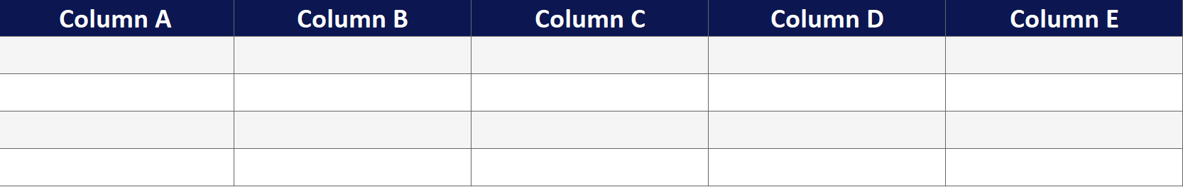
Brand assets sample
Note that these assets are for demonstration purposes only; you will need to replace these brand assets with your company logo, slide, and sample table.
© All rights reserved for Dr. Ryan Ahmed @Stemplicity Inc.

Slide 37
SLASH COMMANDS

Slide 38
Slash Commands Summary
Located in .claude/commands/ — type the command name to run
/setup
First-run onboarding: install skills, build identity, configure brand, initialize vault & Notion
/new
Create a new automation: scaffold folder, CLAUDE.md, Notion DB, command, vault entries
/status
What's happening: recent runs, project progress, upcoming tasks (quick or full mode)
/ingest
Process raw sources into wiki pages with [[links]], extract people & companies
/lint
Vault health check: orphans, stale pages, broken links, contradictions, data gaps
/brand
Set up or refresh brand config from templates, logos, and color/font preferences

Slide 39
Thank you!

